Slide 1

Computer Networks
IEEE 802.11- Wireless LAN
S.V.Jansi Rani
Associate Professor / CSE

Slide 2
AGENDA
Introduction
Architectural comparison
Characteristics
Access Control
IEEE 802.11
Architecture
BSS,ESS, Station types
MAC Sublayer
DCF
PCF
Fragmentation
Frame Format
Frame types
Addressing mechanism -exposed station problem

Slide 3
AGENDA
Physical Layer
Bluetooth
Architecture
Piconet
Scatternet
Bluetooth devices
Layers
Bluetooth layer
Frame format
Radio layer

Slide 4



Slide 5
INTRODUCTION

Slide 6
INTRODUCTION
Wireless communication is one of the fastest-growing technologies.
The demand for connecting devices without the use of cables is increasing everywhere.
Wireless LANs can be found on college campuses, in office buildings, and in many public areas.

Slide 7
INTRODUCTION - Architectural Comparison
Medium
Wired - conn-p2p / mp
Wireless - air - broadcast
Host
wired -move with MAC address
wireless - no phy con
Isolated wired LAN & wireless LAN

Slide 8
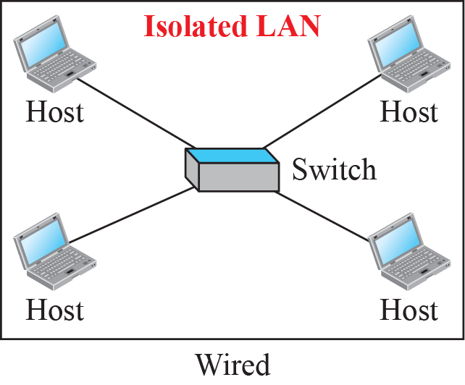
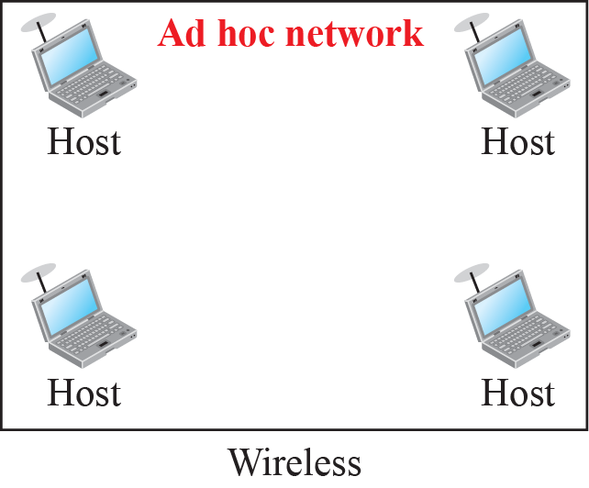
Isolated LANs: wired versus wireless

Slide 9
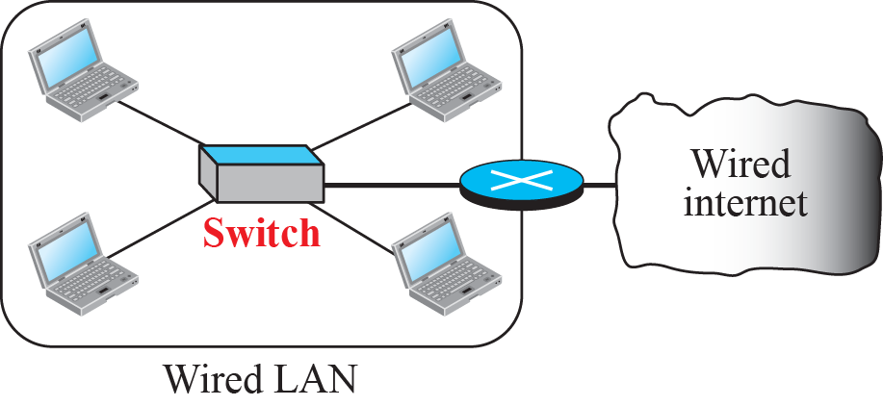
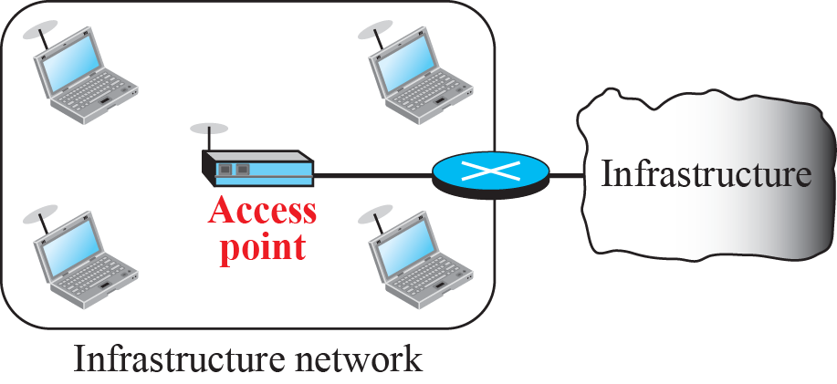
Connection of a wired LAN and a wireless LAN to other
networks

Slide 10
Characteristics
Attenuation - signal disperses in all directions, signal strength decreases
Interference - receive signal from others
Multipath Propagation - more than one signal from same sender at different phases
Error -SNR - high

Slide 11
Access Control
The CSMA/CD algorithm does not work in wireless LANs for three reasons:
Wireless hosts do not have enough power to send and receive at the same time.
The hidden station problem prevents collision detection
The distance between stations can be great.
Wireless LAN uses CSMA/CA

Slide 12
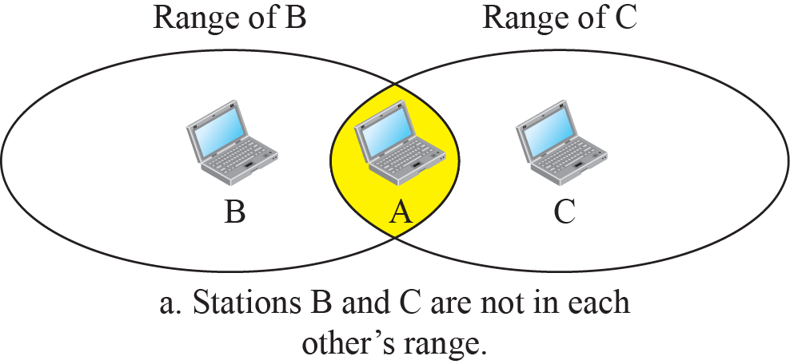
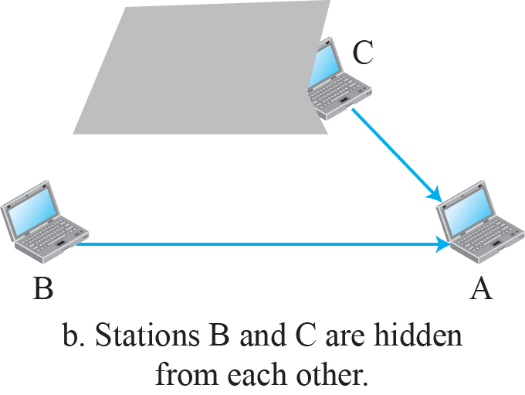
Hidden station problem

Slide 13
iEEE 802.11 wlan

Slide 14
IEEE 802.11 PROJECT
IEEE has defined the specifications for a wireless LAN, called IEEE 802.11- wireless Ethernet.
Public uses the term WiFi (short for wireless fidelity) as a synonym for wireless LAN.
WiFi, however, is a wireless LAN that is certified by the WiFi Alliance.

Slide 15
Architecture
The standard defines two kinds of services:
Basic service set (BSS)
Extended service set (ESS).

Slide 16
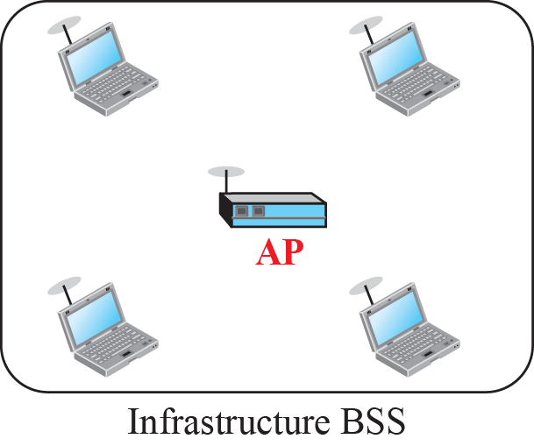
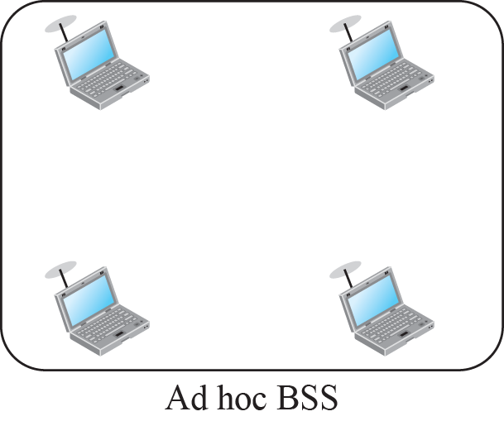
Basic service sets (BSSs)

Slide 17
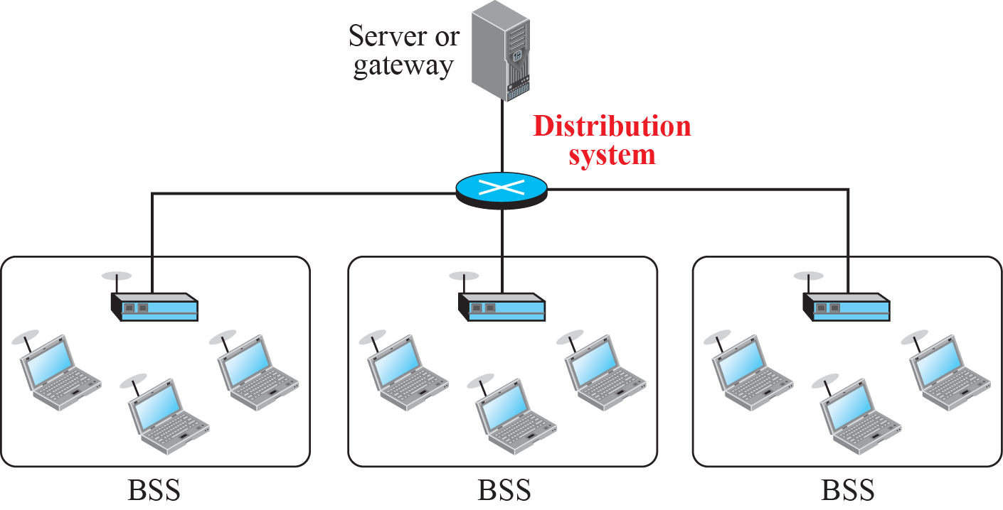
Extended service set (ESS)
ESS -stationary / mobile stations

Slide 18
Station Types
No Transition
BSS Transition Mobility
ESS Transition Mobility

Slide 19
MAC Sublayer
IEEE 802.11 defines two MAC sublayers:
Distributed coordination function (DCF)
Point coordination function (PCF).

Slide 20
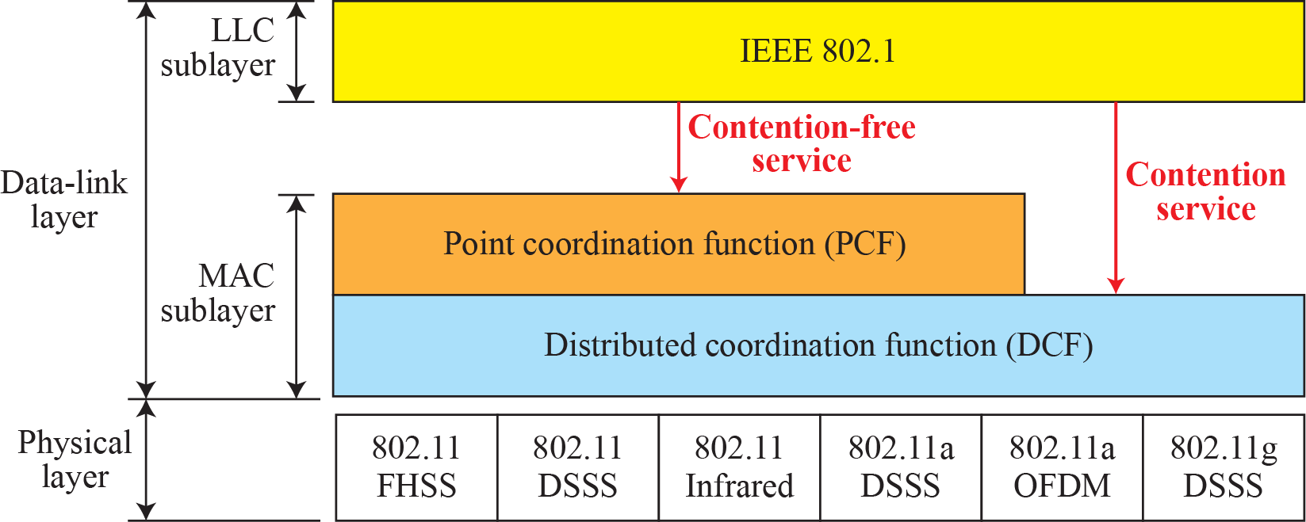
MAC layers in IEEE 802.11 standard

Slide 21

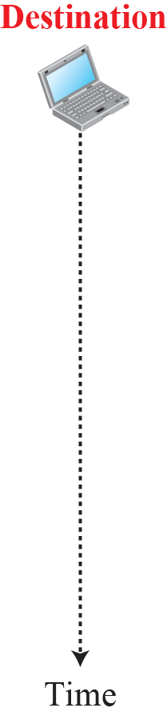










CSMA/CA and NAV

Slide 22
Point Coordination Function (PCF)
It is implemented on top of the DCF and is used mostly for time-sensitive transmission.
PCF has a centralized, contention-free polling access method
The AP performs polling for stations that are capable of being polled.
To give priority to PCF over DCF, another interframe space, PIFS, has been defined. PIFS (PCF IFS) is shorter than DIFS.
To prevent domination of PCF, a repetition interval has been designed to cover both contention-free PCF and contention-based DCF traffic.
Beacon frame - NAV

Slide 23
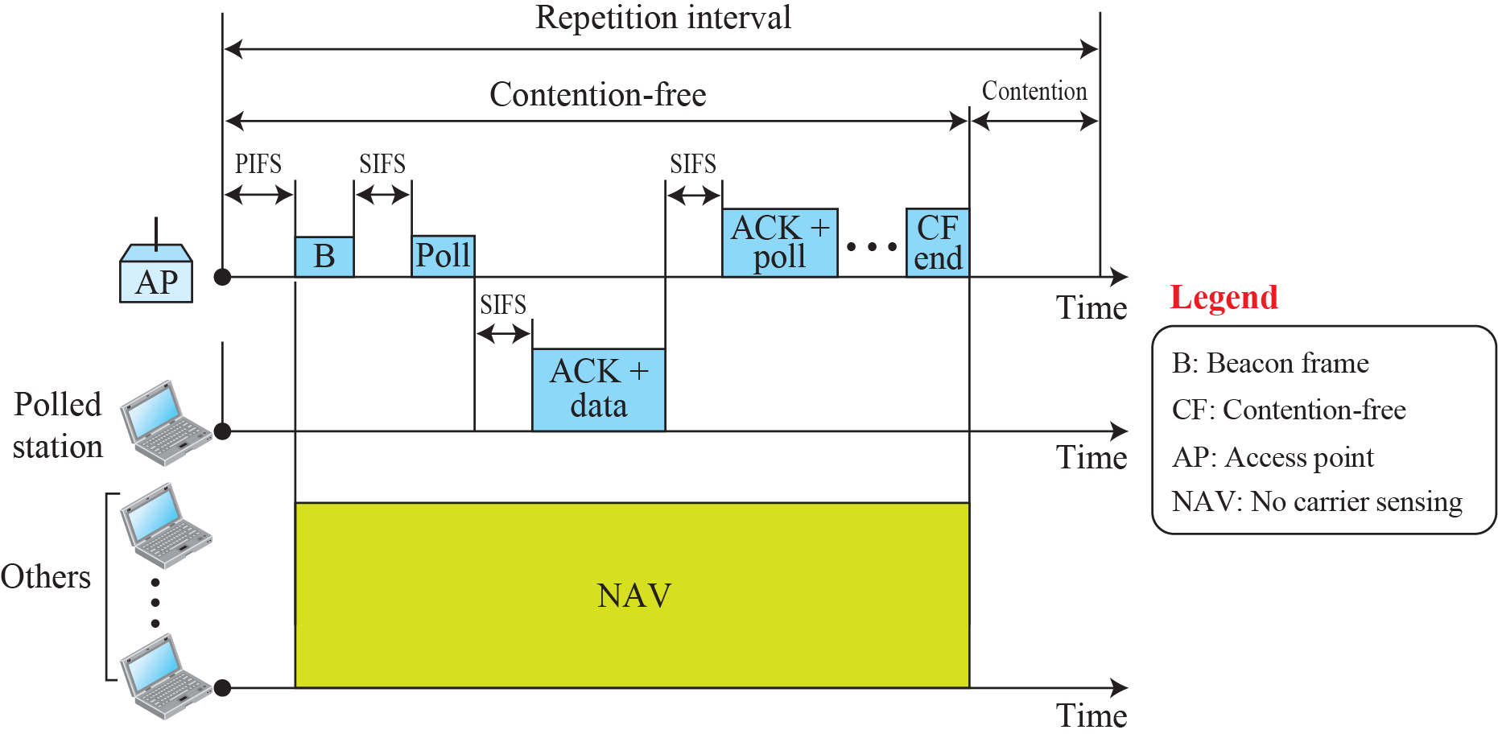
Example of repetition interval

Slide 24

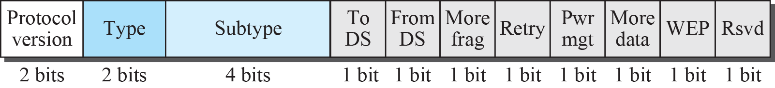
Frame format

Slide 25
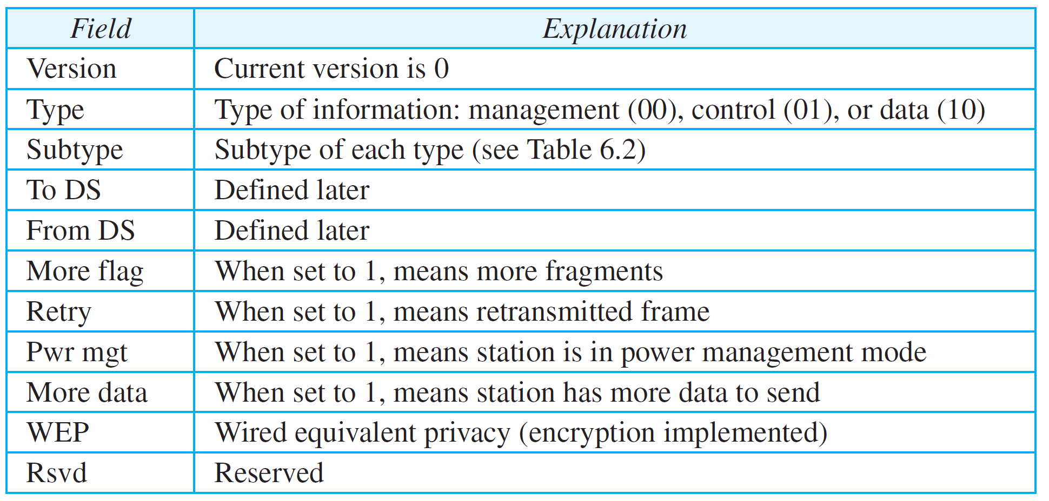
Subfields in FC(Frame Control) field

Slide 26
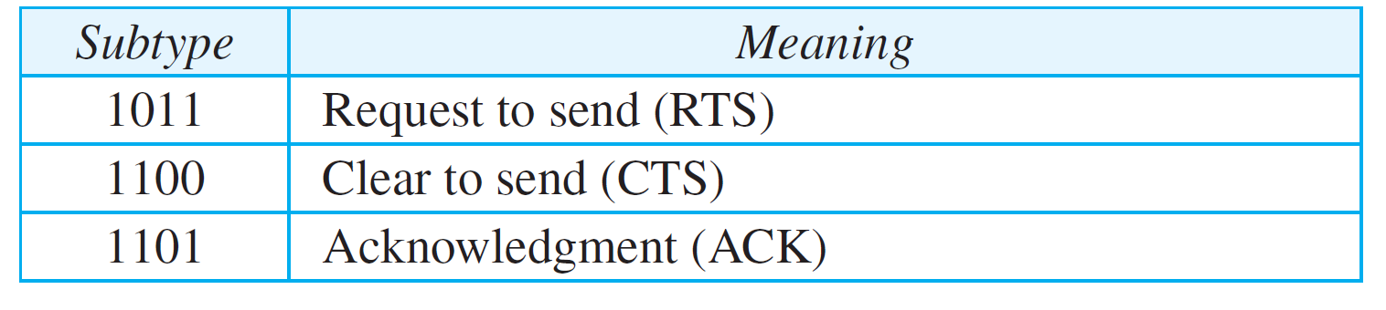
Values of subfields in control frames

Slide 27
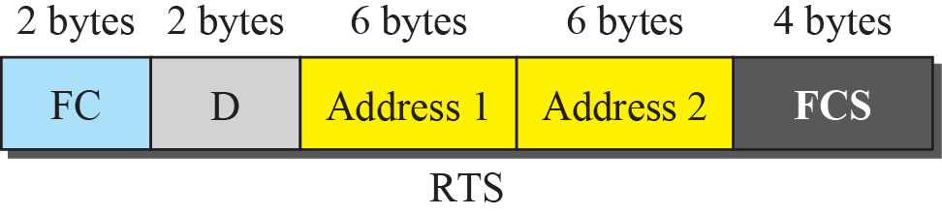
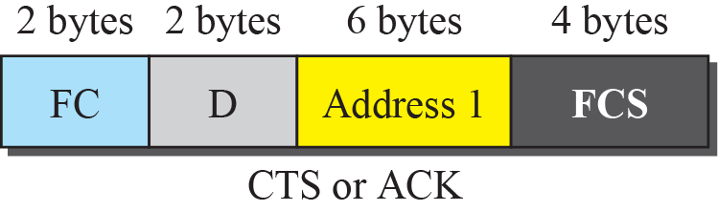
Control frames

Slide 28
Addressing Mechanism
The IEEE 802.11 addressing mechanism specifies four cases, defined by the value of the two flags in the FC field, To DS and From DS.
Each flag can be either 0 or 1, resulting in four different situations.
The interpretation of the four addresses (address 1 to address 4) in the MAC frame depends on the value of these flags

Slide 29
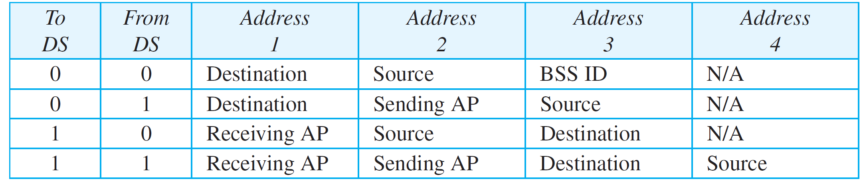
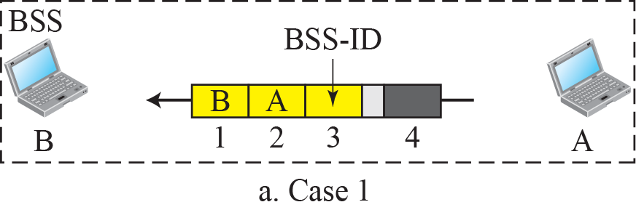
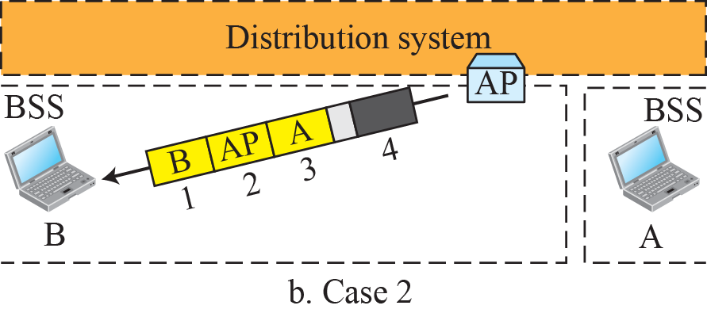
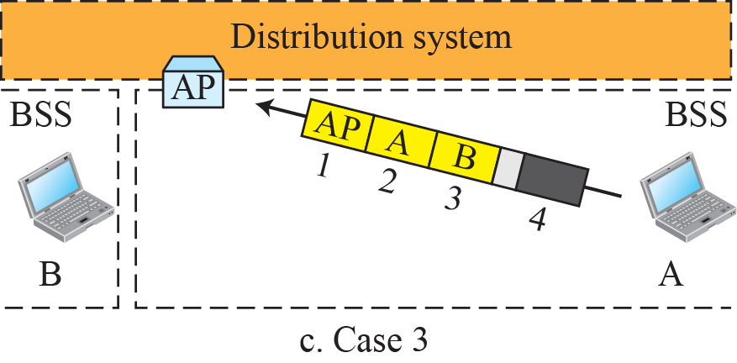
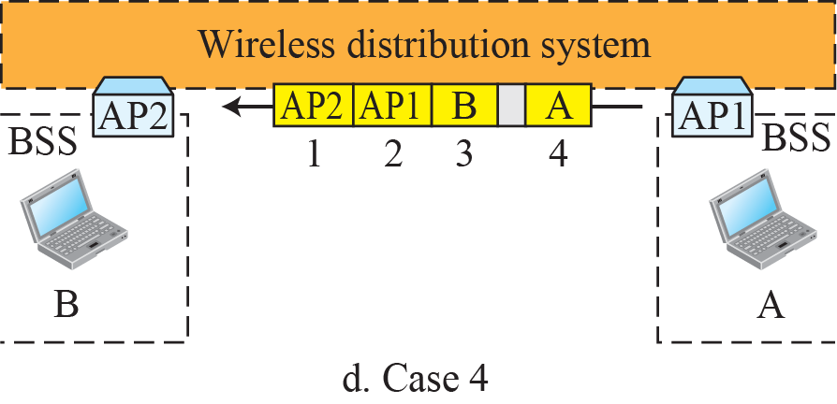
Addressing mechanisms

Slide 30
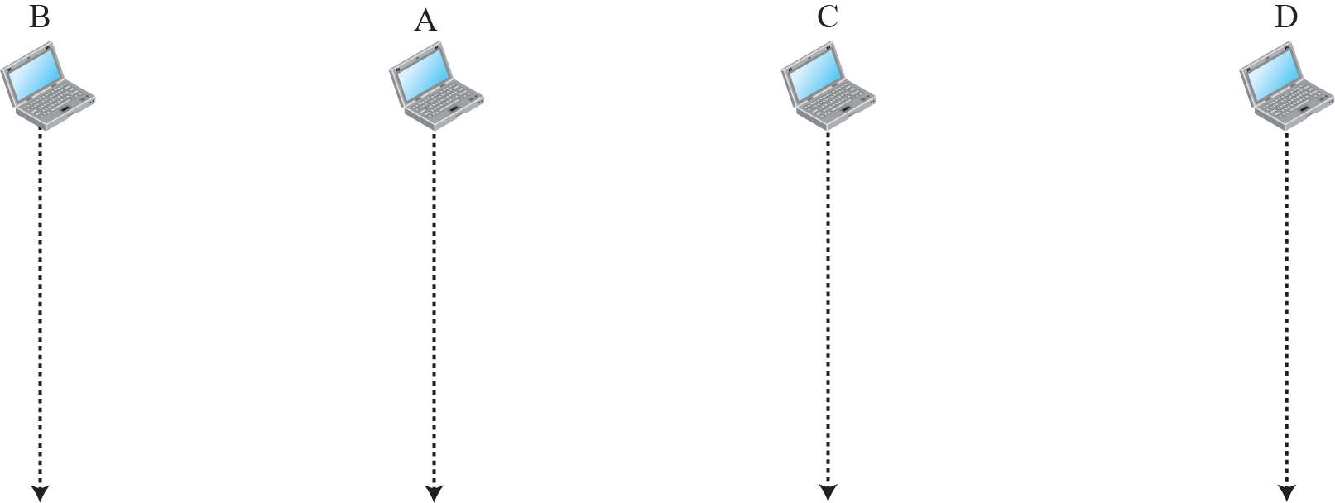
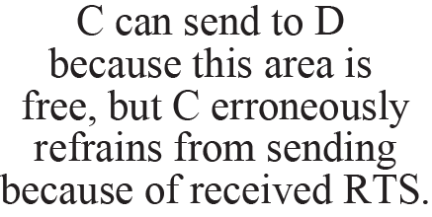


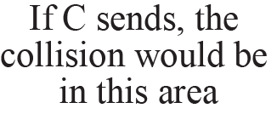
Exposed station problem

Slide 31
Physical Layer
Six specifications
All implementations, except the infrared, operate in the industrial, scientific, and medical (ISM) band, which defines three unlicensed bands in the three ranges 902–928 MHz, 2.400–4.835 GHz, and 5.725–5.850 GHz.

Slide 32
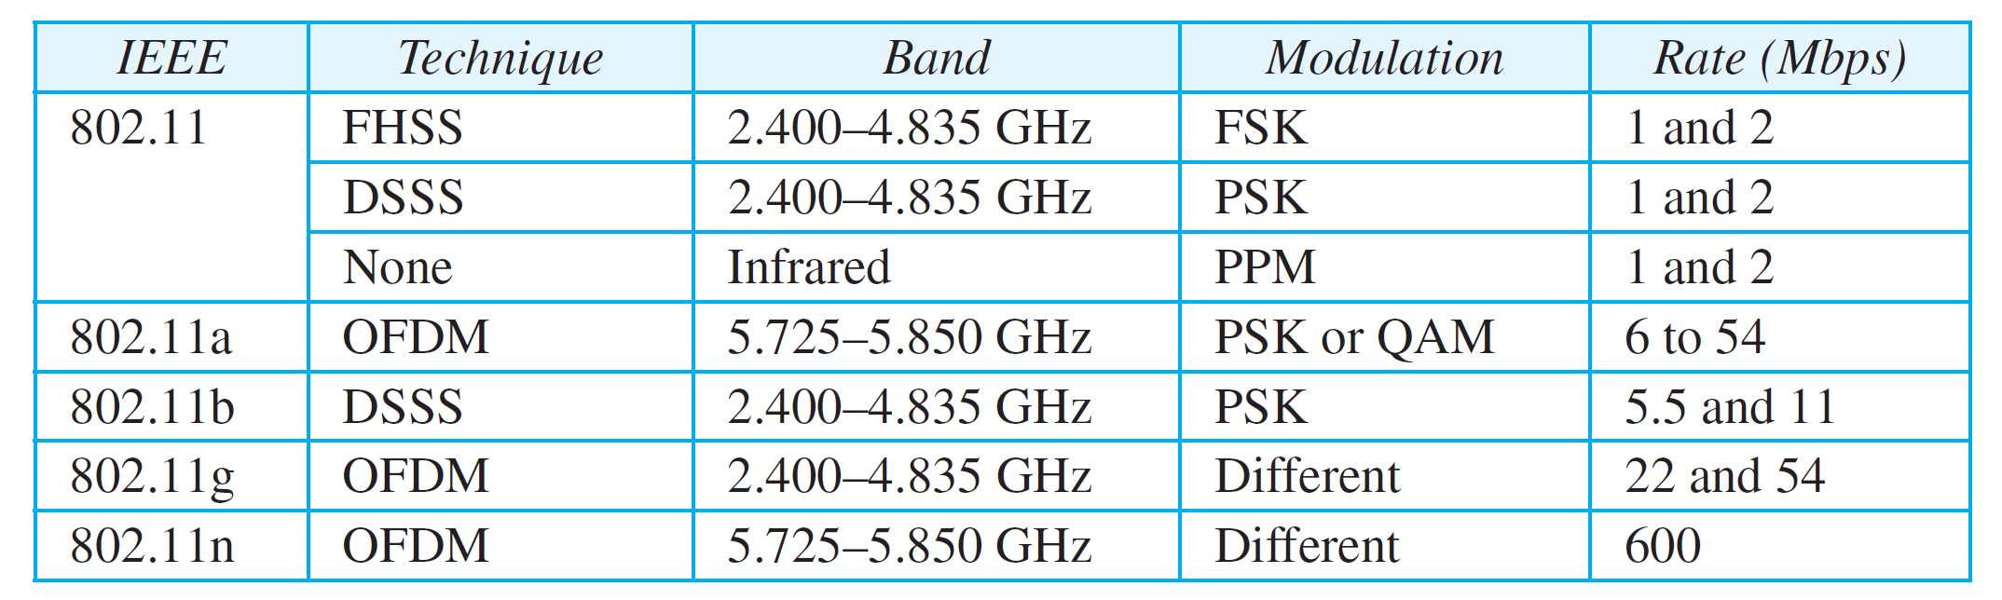
Specifications

Slide 33
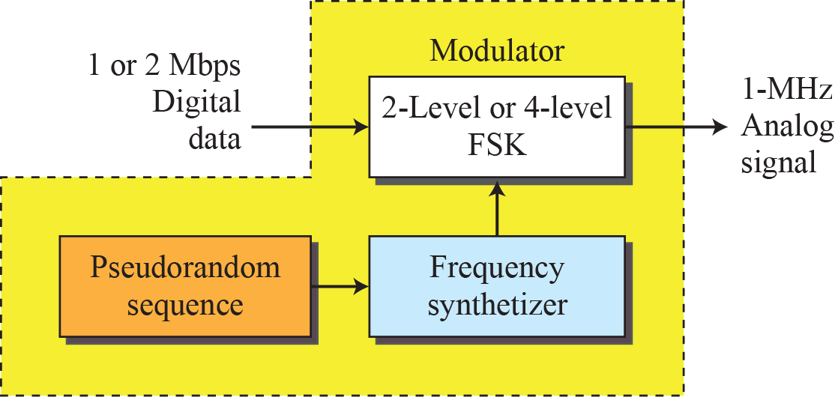
Physical layer of IEEE 802.11 FHSS

Slide 34
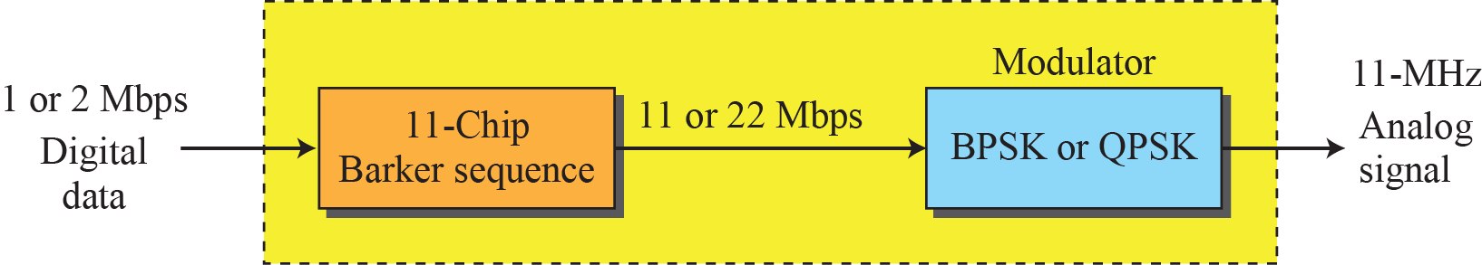
Physical layer of IEEE 802.11 DSSS

Slide 35
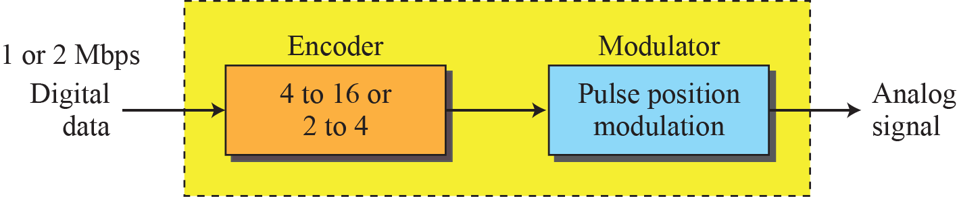
Physical layer of IEEE 802.11 infrared

Slide 36
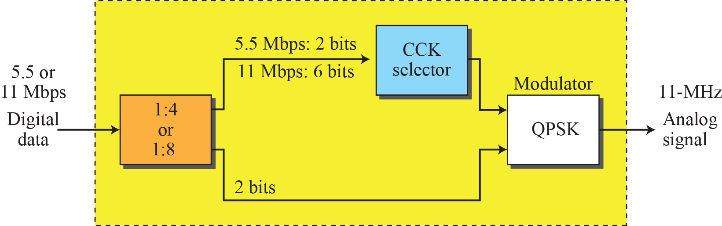
Physical layer of IEEE 802.11b

Slide 37
Check Your Understanding
What is the use of repetition intervals in WLAN
Difference between PCF and DCF?

Slide 38
Outcome
Student should be able to
Explain the various categories of Wireless LAN technology
Demonstrate the various wireless specific problems
Explain the frame format and addressing schemes of WLAN

Slide 39
THANK YOU

